Slide 2
ON-SITE
ON-DEMAND
CLEANERS, SANITIZERS & DISINFECTANTS

Slide 3
Talking Points
What is Engineered Water?
Why Clean with Engineered Water?
Who is CleanCore Solutions?
Clemson University Health Case Study
Distribution Partner Support!
CleanCore Customers!
CleanCore Aqueous Ozone Product Offering
CleanCore Solutions Powered by Saltwater Biocides
University of Central Florida-Orlando, FL
St. Thomas University-Miami, FL
Salt Lake Public Schools-Salt Lake City, UT
Bonneville Public Schools-Idaho Falls, ID

Slide 4
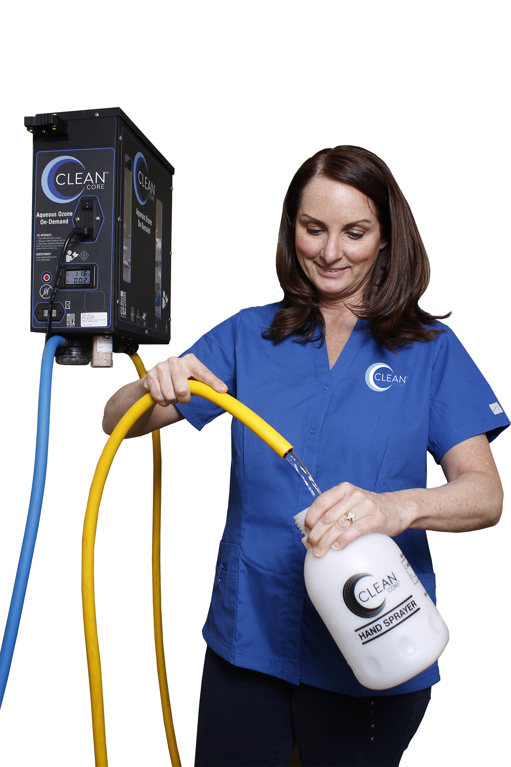
What is Engineered Water?
A term used for a natural, alternative cleaning, deodorizing and/or disinfecting solution
Intended to replace synthetic chemicals in the cleaning process
Engineered Water is generated by using tap water, electricity and an additive, to create a cleaning and deodorizing solution.

Slide 5
Who is CleanCore Solutions?
A green-cleaning technology company, headquartered in Omaha, Nebraska since 2010
Developed a patented technology that generates a sustainable, natural cleaning solution called Aqueous Ozone
Key Sectors Served:
Health Care
Airports
Schools & Universities
Corrections
Animal Care
Government Agencies
Manufacturing

Slide 6
How Does Aqueous Ozone Work?

Slide 7
^{Clemson University Case Study}
Since 2017 Clemson University has been using CleanCore Solutions Pure Aqueous Ozone as a non-synthetic alternative for their residence halls. Key findings have included…..
Use of conventional cleaners reduced by 65%
Glass Cleaner reduced by 75%
Water use reduced by 90%
Amount of plastic and cardboard diverted from landfills reduced by 70%
ATP Percent reduction on fixtures over 82%

Slide 8
C
^{CleanCore Customers!}

Slide 9
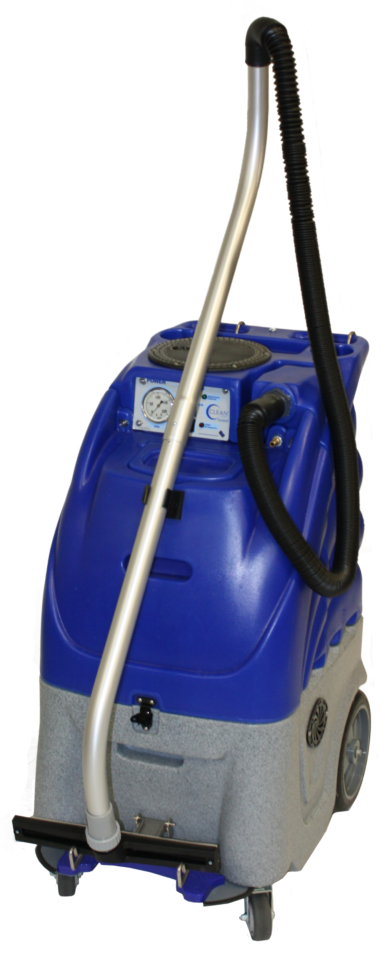
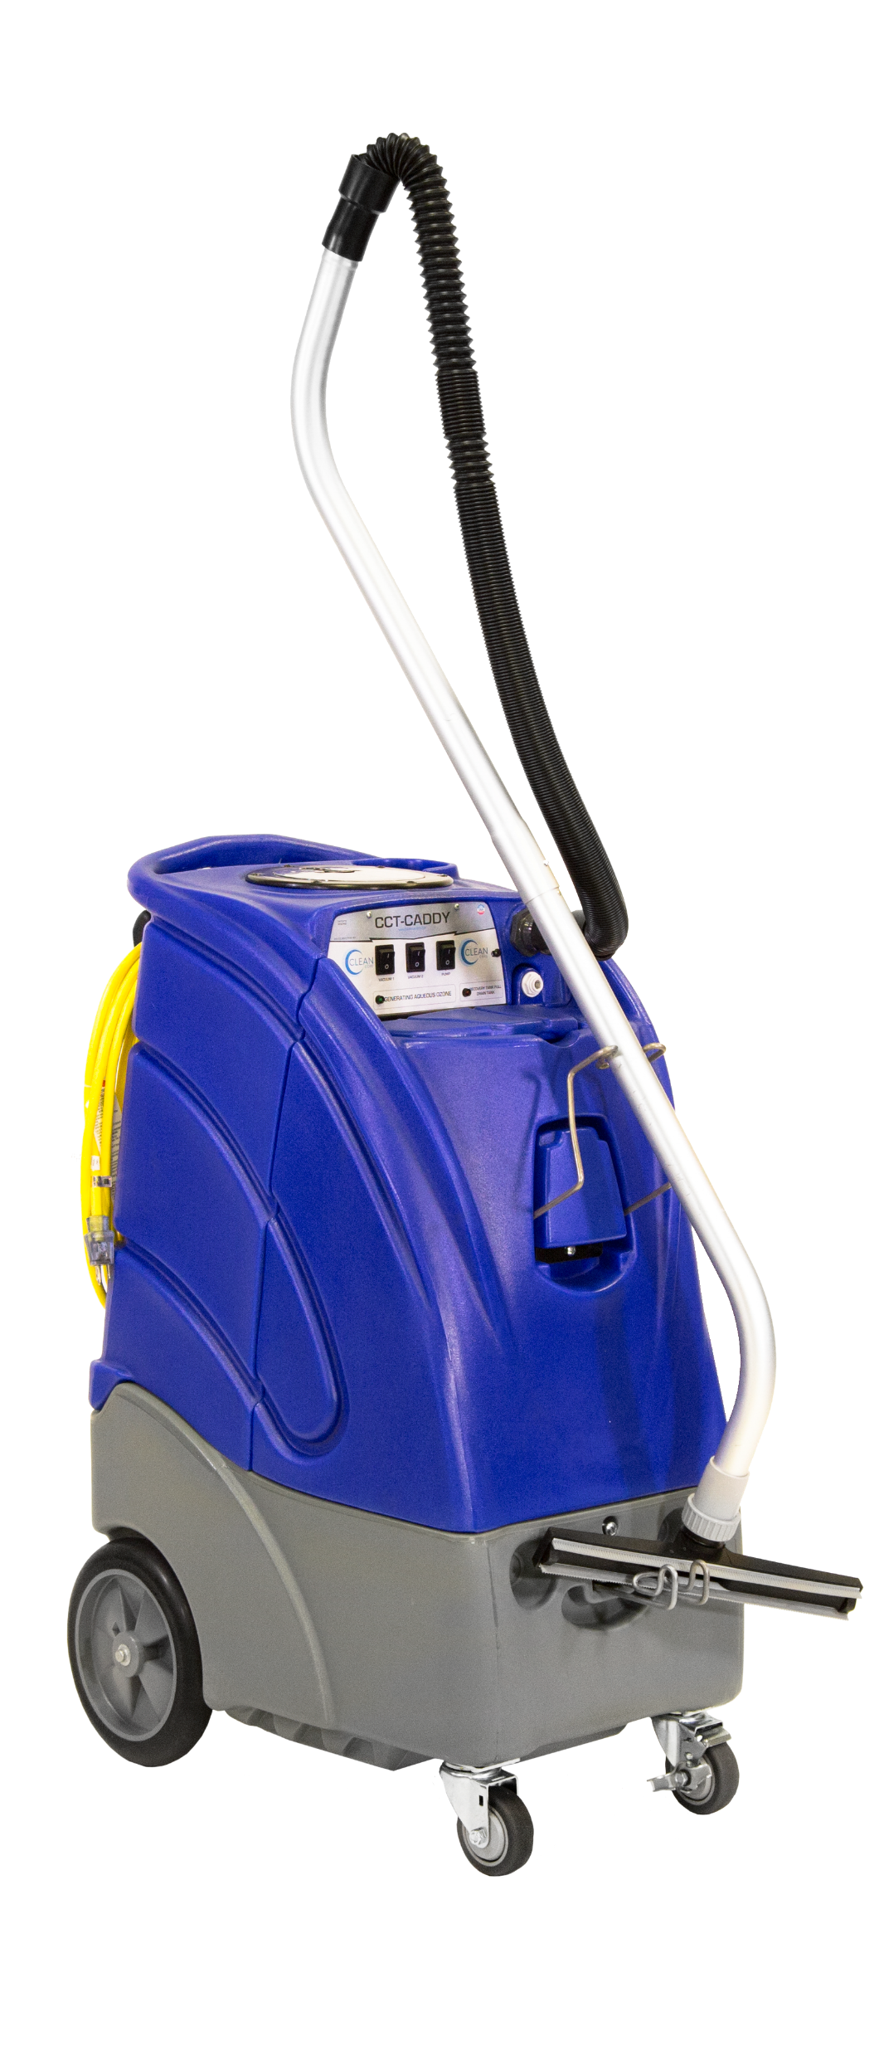
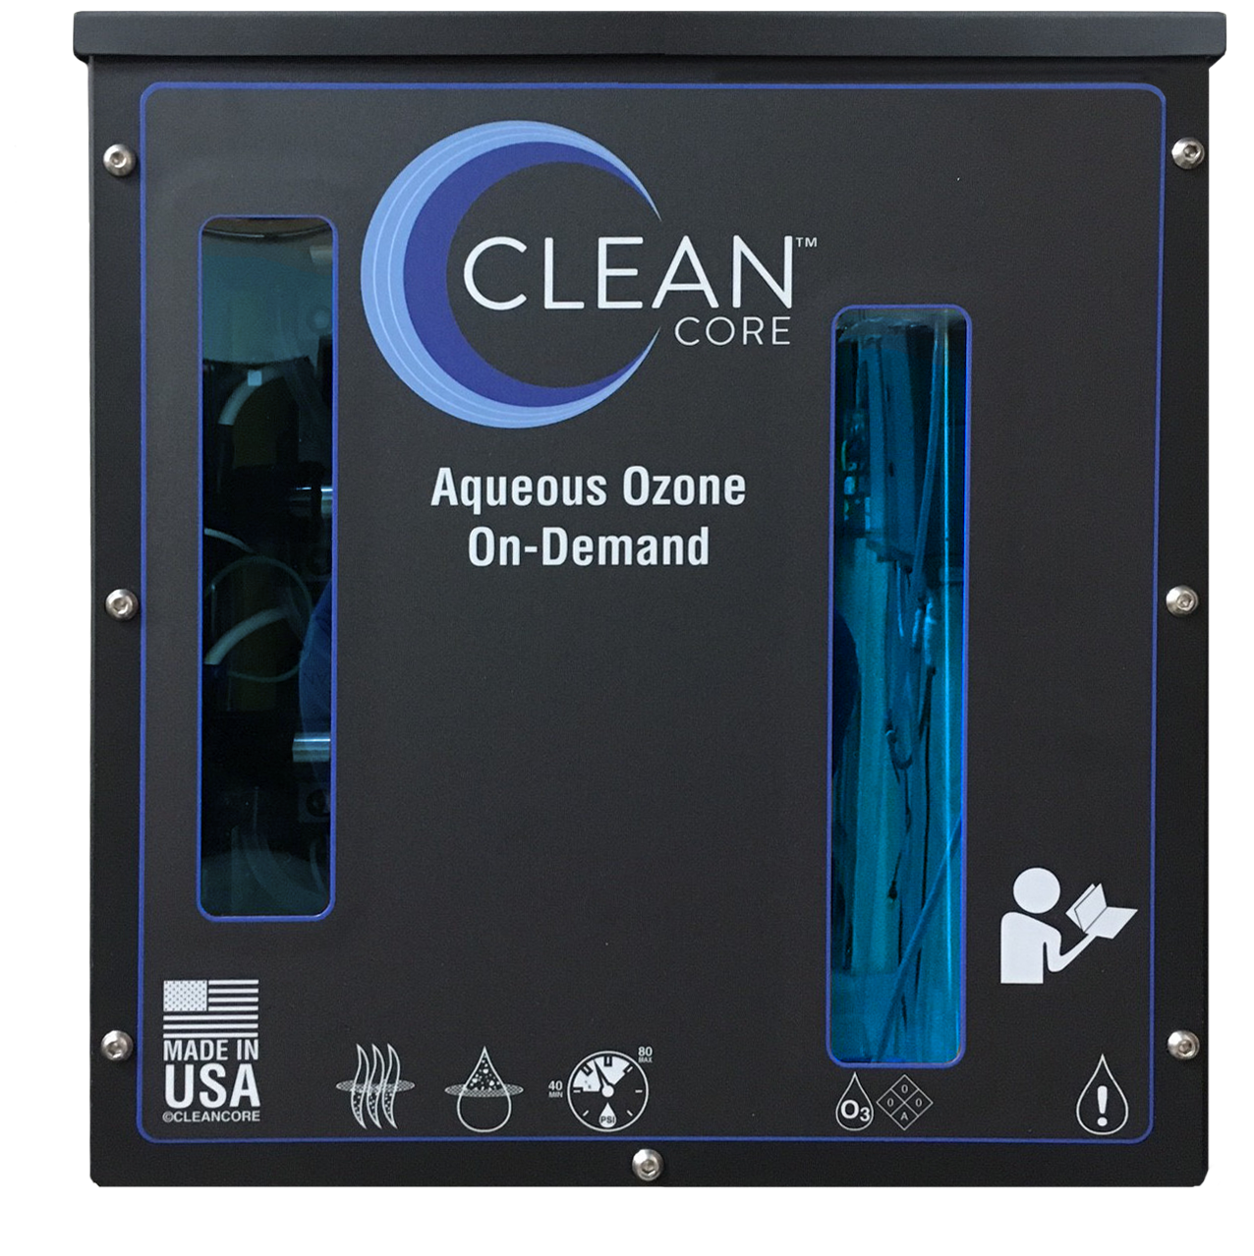
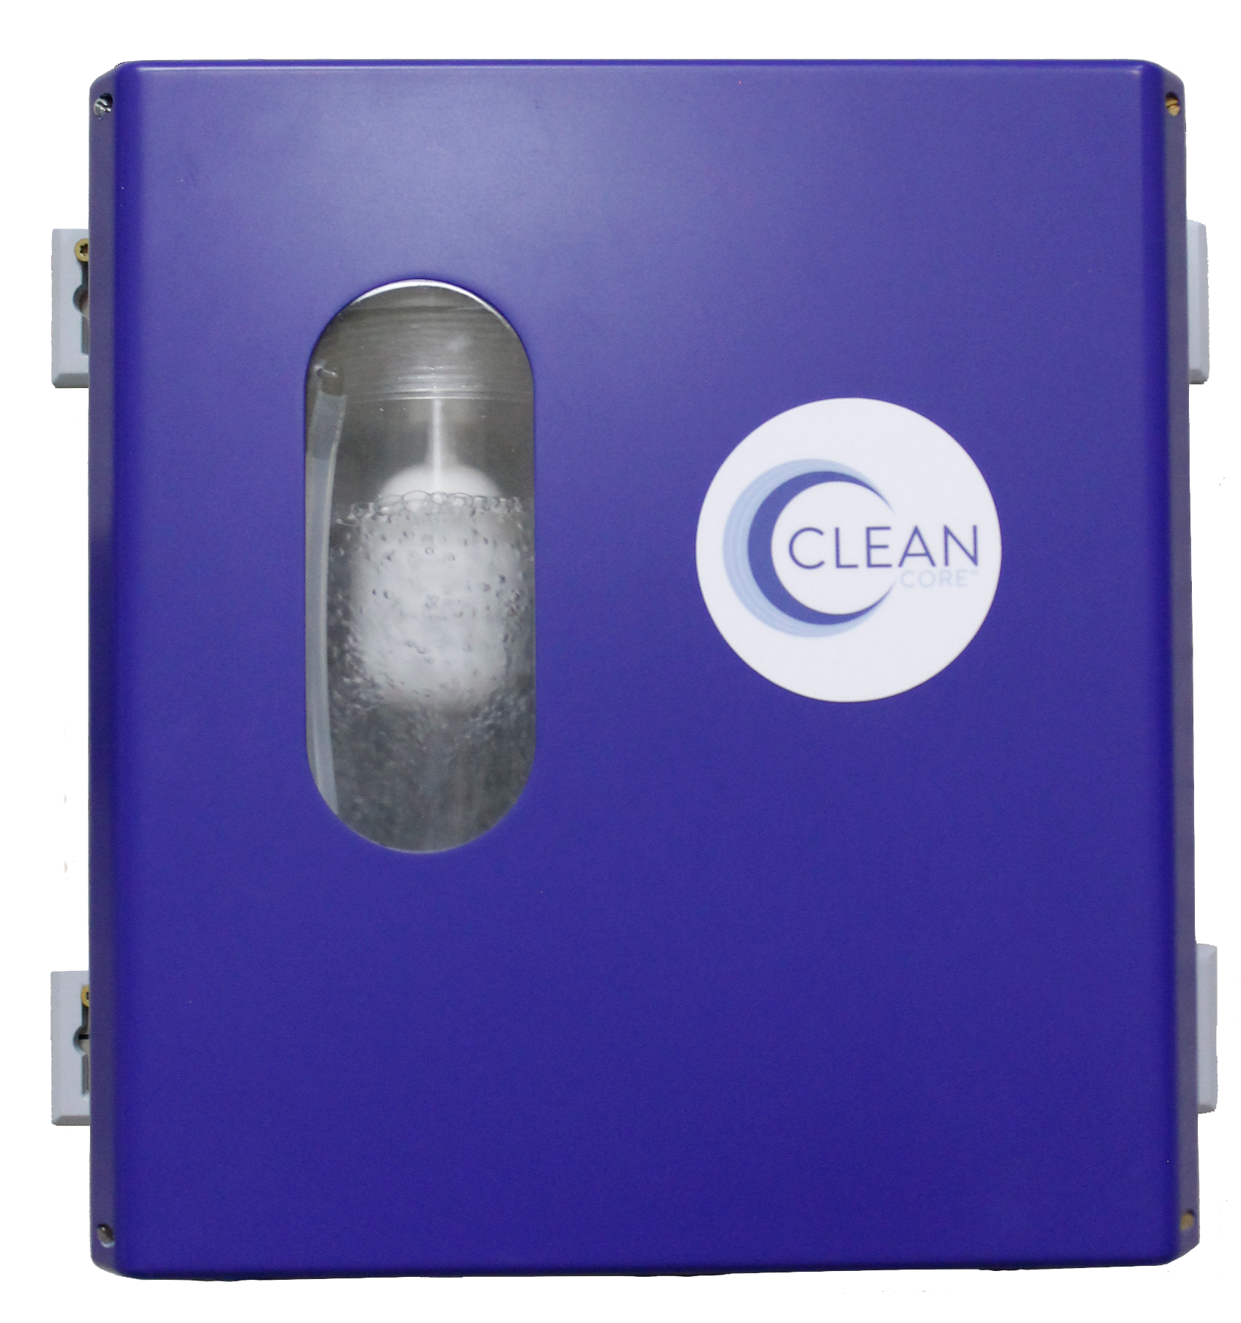
JanSan Product Offering
POWERcaddy
CCT Caddy
MINIcaddy
CCT Spotter
CCT 3.0 Fill Station
CCT 1.0 Fill Station

Slide 10
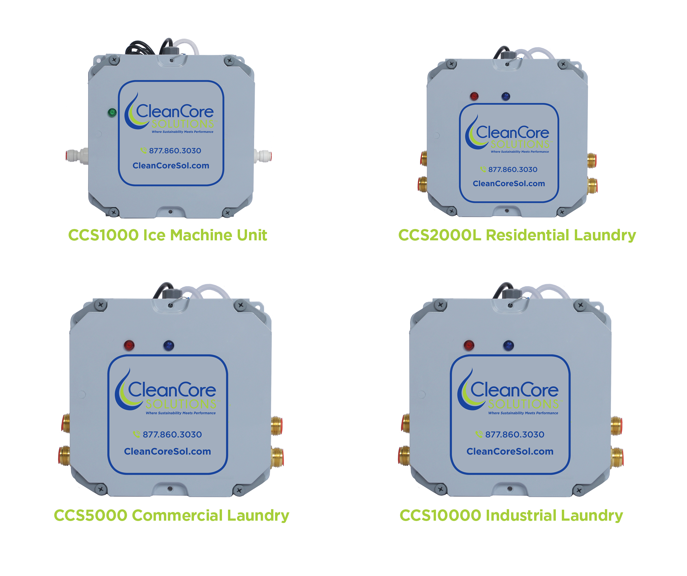
Ice and Laundry Product Offering

Slide 19
Questions?
Thank You!
Ward Prine
wprine@cleancoresol.com
402-630-6216
www.CleanCoreSol.com

